Slide 1


WSN localization with Senseless
Peter De Cauwer
Tim Van Overtveldt

Slide 2
Team
Students:
Peter De Cauwer
Tim Van Overtveldt
Promotors:
Jeroen Doggen
Jerry Bracke
Maarten Weyn

Slide 3
Overview
Contributions
Motivation
Applications
WSN as a RTLS
Framework
Localization
Results
Conclusion
Future work
Q&A

Slide 4
Overview
Contributions
Motivation
Applications
WSN as a RTLS
Framework
Localization
Results
Conclusion
Future work
Q&A

Slide 5
Contributions
Expand Senseless framework to incorporate localization with RSSI
Compare different algorithms
Test the influence of the orientation of a node
Interface this framework to Scala

Slide 6
Overview
Contributions
Motivation
Applications
WSN as a RTLS
Framework
Localization
Results
Conclusion
Future work
Q&A

Slide 7
Overview
Contributions
Motivation
Applications
WSN as a RTLS
Framework
Localization
Results
Conclusion
Future work
Q&A

Slide 8
Wireless Sensor Network
A wireless sensor network (WSN) is a wireless network consisting of spatially distributed autonomous devices using sensors to cooperatively monitor physical or environmental conditions, such as temperature, sound, vibration, pressure, motion or pollutants.

Slide 9
Motivation
What?
To determine the physical coordinates of a group of sensor nodes in a wireless sensor network (WSN)
Due to application context and massive scale, use of GPS is unrealistic, therefore, sensors need to self-organize a coordinate system
Why?
To report data that is geographically meaningful
Services such as routing rely on location information; geographic routing protocols; context-based routing protocols, location-aware services

Slide 10
Overview
Contributions
Motivation
Applications
WSN as a RTLS
Framework
Localization
Results
Conclusion
Future work
Q&A

Slide 11
Overview
Contributions
Motivation
Applications
WSN as a RTLS
Framework
Localization
Results
Conclusion
Future work
Q&A

Slide 12
Applications
Environmental monitoring (air, water, soil chemistry, surveillance)
REDWOOD
Home automation (smart home)
Inventory tracking (in warehouses, laboratories)

Slide 13
Overview
Contributions
Motivation
Applications
WSN as a RTLS
Framework
Localization
Results
Conclusion
Future work
Q&A

Slide 14
Overview
Contributions
Motivation
Applications
WSN as a RTLS
Framework
Localization
Results
Conclusion
Future work
Q&A

Slide 15
RTLS - Definitions
Anchor Nodes:
Nodes that know their coordinates a priori
By use of GPS or manual placement
For 2D three and 3D four anchor nodes are needed
Goal: to position a blind node by using pair-wise measurements with the anchor nodes.
Anchor-based

Slide 16
RTLS - 2 phases
1. Determine the distances between blind nodes and anchor nodes.
2. Derive the position of each node from its anchor distances.

Slide 17
RTLS - Phase 1
Range-less
Connectivity
Hop Count
Sum-Dist
Dv-Hop
Euclidean
Range-based
Ranging methods

Slide 18
RTLS - Phase 1 - Range-based
TOA
TDOA
RTT
AOA
RSS

Slide 19
RTLS - Phase 1 - Range-based
TOA
TDOA
RTT
AOA
RSS

Slide 20
Phase 1 – Range-based (RSS)
Radio signals attenuate with distance
Available in most radios
No extra cost
Poor accuracy
Difficult to model

Slide 21
RSS - Errors
Environmental errors
Multipath
Shading
Interference
Gaussian noise

Slide 22
RSS - Errors
Device errors
Transmitter variability
Receiver variability
Antenna orientation

Slide 23
RSS - Model
Different models
log-distance path loss model
RSS(d) = P_{T} - P(d0) – 10 n log(d / d0) + Xo
P_{T} Transmitted power [dBm]
RSS Received Signal Strength[dBm]
P(d0) Path loss in dBm at a distance of d0
n Path loss exponent
d Distance between two nodes[m]
d(0) Reference distance[m]: 1m
Xo Gaussian random variable

Slide 24
RTLS - Phase 2
Range-based algorithms
Trilateration
MinMax
Range-less algorithms
CL
WCL

Slide 25
RTLS - Phase 2 - Range-based
Min-Max:
Distance to anchors determines a bounding box
Trilateration:
Uses multiple distance measurements between known points
Must solve a set of linear equation
Notes:
Trilateration: computes position in n dimensions by measuring distance to n+1 reference points
Triangulation: computes position in n dimensions by having measured one distance and n angles
MinMax: a simplified, power-computation lateration, modelling coverage areas with squares instead of circles
Proximity: determines if objects are near known location
Proximity location senses the presence of an object close to a certain point, using a physical phenomenon of limited range:
– detecting physical contact (pressure sensors, touch sensors, capacitive field detectors) or ID security systems (points-of-sale, computer logins, telephone records)
– monitoring roaming (access point associations)s, using a physical phenomenon of limited range

Slide 26
RTLS - Phase 2 - Range-less
CL
WCL
0.0 ; 0.0
3.0 ; 0.0
1.5 ; 1.5
0.0 ; 3.0
3.0 ; 3.0

Slide 27
RTLS - Properties
Centralized
RSS-based
Robust
Adaptive
Anchor-based

Slide 28
Overview
Contributions
Motivation
Applications
WSN as a RTLS
Framework
Localization
Results
Conclusion
Future work
Q&A

Slide 29
Overview
Contributions
Motivation
Applications
WSN as a RTLS
Framework
Localization
Results
Conclusion
Future work
Q&A

Slide 30
Framework
Product of the thematic ICT week:
WSN Middleware
Software framework:
WSN (Telos rev. B & Sun Spot)
Controller + database
GUI
Distributed

Slide 31
Framework
Data interface to the WSNs and GUIs
XML
Database
Stored Procedures
Localization algorithms
Centralized

Slide 32
Framework - Technologies
WSN
TinyOS
TelosB
Xubuntos
WSN XML Parser
Java
Controller, GUI
C#
.NET 2.0
Interfaces
XML over TCP
WCF (http)

Slide 33
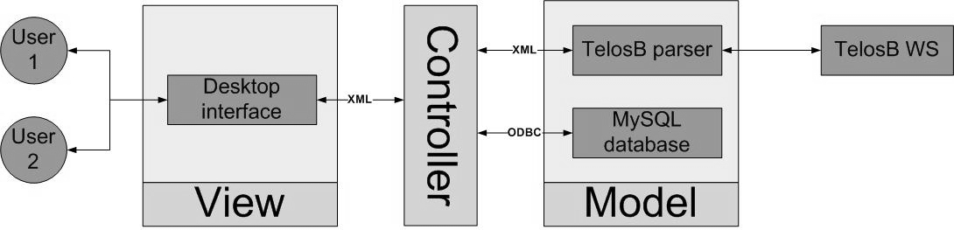
Framework - MVC
Model View Controller design

Slide 34
Framework - MVC
Advantages:
The addition of new Views en Models
Independance

Slide 35
Framework - SOA
Service Oriented Architecture
Advantages:
Modularity and flexibility
Scalability
Reusage

Slide 36
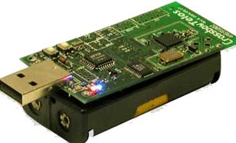
WSN - Telos rev. B
TI MSP430 microcontroller with 10kB RAM
Ultra low-power
IEEE 802.15.4 compliant radio
Integrated temperature, light, humidity and voltage sensor
Programmable via USB interface
TinyOS 2.X compatible
Integrated antenna

Slide 37
WSN - TinyOS
Most popular OS for Wireless Sensor Networks
Open source
Energy efficient – low power
Hurry up and go to sleep!
Split phase commands
Multi-platform

Slide 38
WSN - TinyOS
Small footprint (x KB)
No separate OS & user memory space
No multithreading
No virtual memory
Static memory usage
Memory is allocated at compile-time

Slide 39
WSN - TinyOS
Primary functions:
Sensing
Actuating
Communication
Collection
Dissemination

Slide 40
TinyOS - Programming
Modular source code
Two type of source files
Modules
Logic
Configurations
Bindings via interfaces
All components use and provide interfaces
Events
Commands

Slide 41
TinyOS - nesC
TinyOS is competely programmed in nesC
Interfaces
Tasks
atomic
nesC is a C dialect
.nc
Source code passes through a preproccessor
C-code
Gcc

Slide 42
TinyOS
Still very experimental & academic
Limited support
No development environment
No debugger
Printf library

Slide 43
WSN
Three different roles:
Root Node
Anchor Node
Blind Node

Slide 44
WSN
Three different messages:
Sensor
Location
Status

Slide 45
WSN - Sensor message
Battery (voltage)
Light
Humidity
Temperature
Button pressed
Mote ID

Slide 46
WSN - Location message
Mote id
Anmoteid
VANs
VANr
Hop count
RSSI

Slide 47
WSN - Status message
Mote id
Active
AN
Posx
Posy
Samplerate
locRate
leds
power
frequency

Slide 48
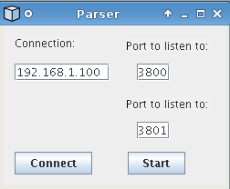
WSN - Parser

Slide 49
Database
MySQL 5.0 database
ODBC
Stored Procedures

Slide 50
Controller
Core of the system
Gatekeeper to the database
Central gathering point
Localization support
Interface to SCALA

Slide 51
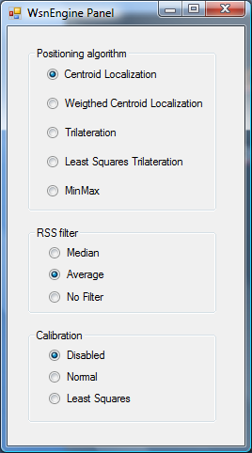
Controller - WSN Engine panel

Slide 52
Scala
RTLS Middleware
Next presentation
Seamless integration of different locating systems
Engine: our system
Middleware: Scala.Core
GUI: SUI

Slide 53
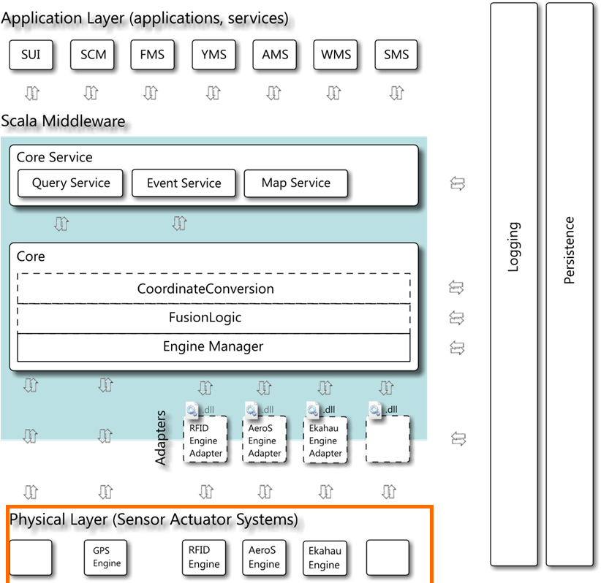
Scala - Engine

Slide 54
Scala
Communication happens via a WCF service
http
Several interfaces
Tag Information
Event
Query
Map
Roughly based on the ANSI RTLS API

Slide 55
Scala - Data
Location
X
Y
Map
Accuracy

Slide 56
Scala - Data
Temperature
Humidity
Light
Button state

Slide 57
GUI
Monitoring
Controlling the WSN:
Active
Anchor node
Coordinates
Sample rate of location and sensor message
Leds

Slide 58
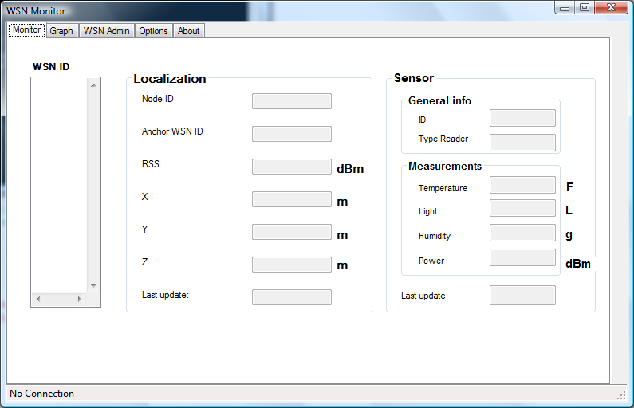
GUI - Monitor

Slide 59
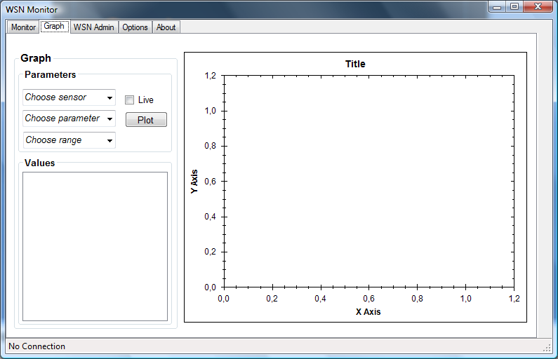
GUI - Graphs

Slide 60
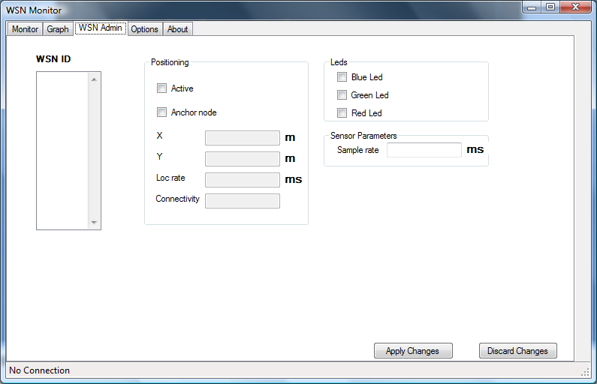
GUI - Control panel

Slide 61
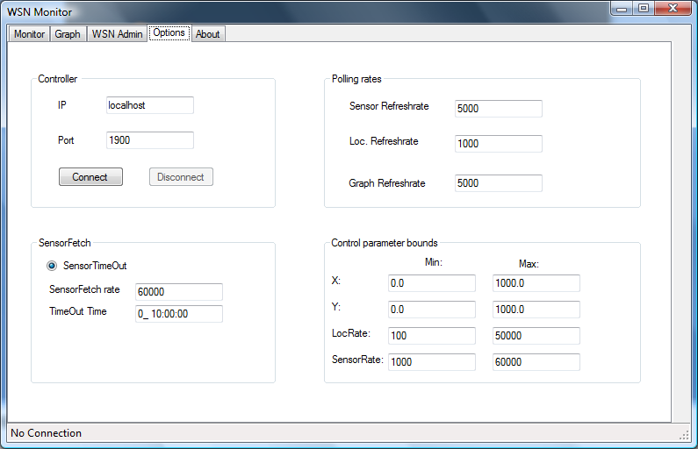
GUI - Options

Slide 62
Overview
Contributions
Motivation
Applications
WSN as a RTLS
Framework
Localization
Results
Conclusion
Future work
Q&A

Slide 63
Overview
Contributions
Motivation
Applications
WSN as a RTLS
Framework
Localization
Results
Conclusion
Future work
Q&A

Slide 64
Localization
2 phases:
Ranging + calibration
Algorithms

Slide 65
Localization - Ranging
RSS(d) = - P(d0) – 10 n log(d / d0)
RSS Received Signal Strength[dBm]
P(d0) Path loss in dBm at a distance of d0
n Path loss exponent
d Distance between two nodes[m]
d(0) Reference distance[m]: 1m

Slide 66
Localization - Ranging
Antenna orientation
Onboard - External
20°
Outdoor
1 & 5 meter

Slide 67
Localization - calibration
Configure anchor nodes with dissemination protocol
Base Mote
attached to PC
Anchor 1
Blind
Anchor 3
Anchor2

Slide 68
Localization - calibration
Confirmation with a status message
Base Mote
attached to PC
Anchor 1
Blind
Anchor 3
Anchor2

Slide 69
Localization - calibration
Broadcast in order to measure RSSI
Base Mote
attached to PC
Anchor 1
Blind
Anchor 3
Anchor2

Slide 70
Localization - calibration
Send back RSSI with the collection protocol
Base Mote
attached to PC
Anchor 1
Blind
Anchor 3
Anchor2

Slide 71
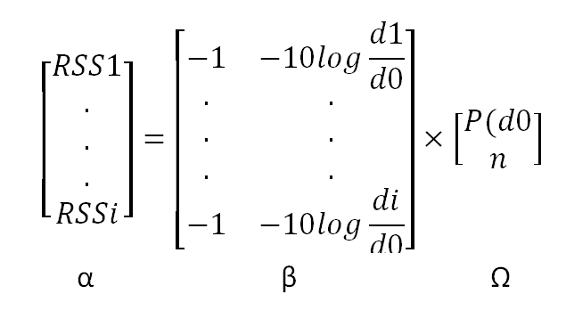

Localization – calibration (LS)
RSS(d) = - P(d0) – 10 n log(d / d0)
RSS Received Signal Strength[dBm]

Slide 72
Localization - Algorithms
Trilateration
Min-Max
CL
WCL

Slide 73
Trilateration
Lateration needs (in theory) distance measurements from:
3 non-collinear references to compute a 2D position

Slide 74
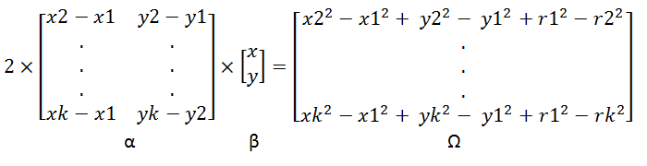

Circle:
(x-x1)² + (y-y1)² = r1 ²
.
.
.
(x-xk)² + (y-yk)² = rk ²

Slide 75
Min-Max
Lateration is computation-heavy; a good simplification models around each anchor node a bounding box and estimates position at the intersection of boxes

Slide 76
Centroid localization
Coarse grained localization
calculate the unknown position as the centroid of the anchor nodes within their communication range
0.0 ; 0.0
3.0 ; 0.0
1.5 ; 1.5
0.0 ; 3.0
3.0 ; 3.0

Slide 77
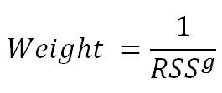
Weighted CL
A weight is coupled to the position of each anchor node by its RSS.
0.0 ; 0.0
3.0 ; 0.0
1
3
2.0 ; 1.0
1
1
0.0 ; 3.0
3.0 ; 3.0

Slide 78
Overview
Contributions
Motivation
Applications
WSN as a RTLS
Framework
Localization
Results
Conclusion
Future work
Q&A

Slide 79
Overview
Contributions
Motivation
Applications
WSN as a RTLS
Framework
Localization
Results
Conclusion
Future work
Q&A

Slide 80
Results – Orientation

Slide 81
Results - Orientation

Slide 82
Overview
Contributions
Motivation
Applications
WSN as a RTLS
Framework
Localization
Results
Conclusion
Future work
Q&A

Slide 83
Overview
Contributions
Motivation
Applications
WSN as a RTLS
Framework
Localization
Results
Conclusion
Future work
Q&A

Slide 84
Conclusion
Successfully enhanced the framework and implemented different localization algorithms
Made a working interface to Scala
Made a WSN Configuration Tool

Slide 85
Conclusion
Each algorithm has a different purpose and diverse properties. Learning from these algorithms and techniques, the correct algorithm can be chosen for the correct environment and a more advanced localization system is feasible.
Spent too much time on the framework, too few on the algorithms

Slide 86
Overview
Contributions
Motivation
Applications
WSN as a RTLS
Framework
Localization
Results
Conclusion
Future work
Q&A

Slide 87
Overview
Contributions
Motivation
Applications
WSN as a RTLS
Framework
Localization
Results
Conclusion
Future work
Q&A

Slide 88
Future work
Simplify the framework
Distributed?
Database and object integrity / ORM
Implement interfaces with WCF
Event-based
C-based serial forwarder under Windows
More algorithms!
Implement algorithms distributed
Find /help develop tool to make developing WSN applications more simple and less time-consuming

Slide 89
Live Demo!

Slide 90
Overview
Contributions
Motivation
Applications
WSN as a RTLS
Framework
Localization
Results
Conclusion
Future work
Q&A

Slide 91
Overview
Contributions
Motivation
Applications
WSN as a RTLS
Framework
Localization
Results
Conclusion
Future work
Q&A

